Slide 1

Control Theory
Department of Electromechanical, Systems and Metal Engineering
Kevin Dekemele, Jasper Juchem, Michel De Roeck

Slide 2
Content (9-12h, 13-14h)
System dynamical properties: Stabilize around equilibrium & observe with disturbance, noise and limited information
Control – an overview
State space
Model & linearization
Stabilization
Feedback & Linear Quadratic Control
Observation & Kalman Filter

Slide 3
Content (14-17h)
Control Architectures
Input-output models
Control Algorithms
LQR
LQG
MIMO control: decoupling
Model Predictive control
Assuming stability & observation, how do we get where we want, given constraints, costs, …. ?

Slide 4
Control: An overview

Slide 5
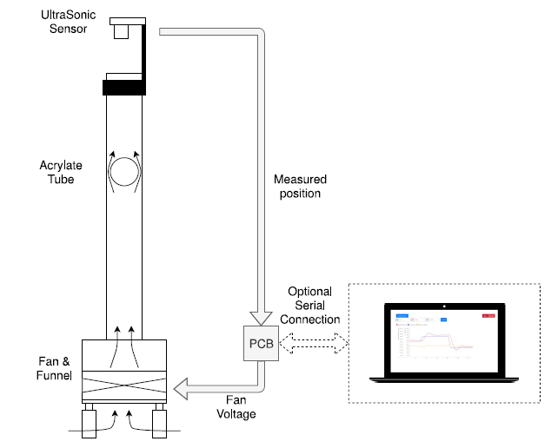
System: levitation of a ball
Notes:
Vandaag zullen we over de basisconcepten gaan in procesdynamica, het regeln of controleren van dergelijke processen. We gaan typisch dynamica caracteristen en verschillende regelstrategin voorstellen.
Om alles wat vatbaarder te maken hebben we een educatieve opstelling, die wordt gebruikt bij de burgerlijk ingenieurs als labo-opdracht voo het vak modelleren en regelen van dynamische systemen.
De bedoeling van deze opstelling is om de bal niet alleen stabiel te krijgen, maar dit ook op eender welke plaats. Op de bal werkt de zwaartekracht, en Via een luchtstroom opgewekt door een ventilator, een weerstandsrakcht (drag force). Simpelweg als de weerstandkracht de zwaartekracht perfect compenseert staat de bal stil. Maar op welke positie.
Ik heb in simple woorden uitgelegt hoe deze opstelling werkt, maar laten we dit systeem nu in een generieker kader gieten om dynamische systemen in het algemeen te bestuderen, het doel van de les.

Slide 6
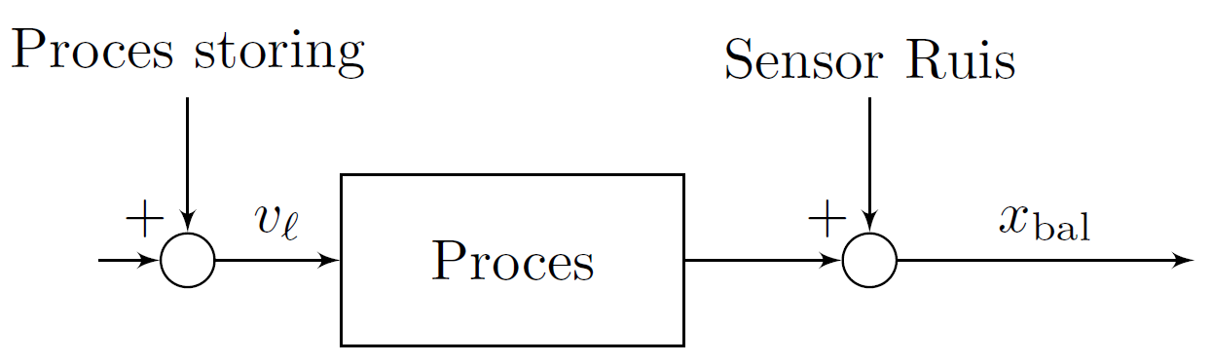
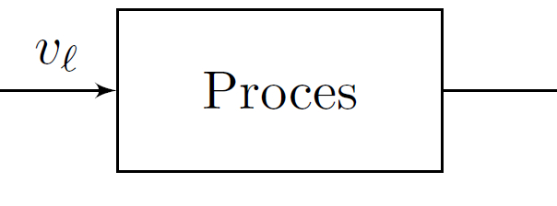
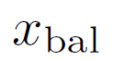
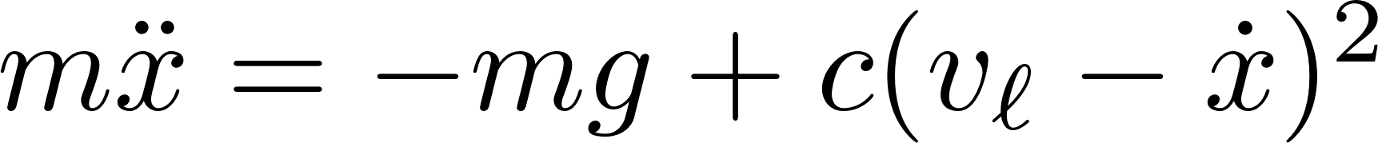
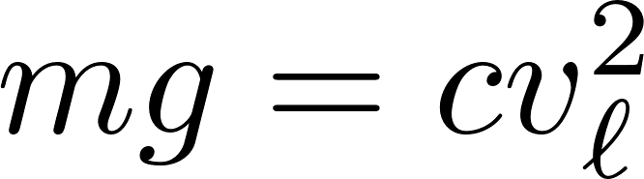
Ideal process
Real process
= Input fully determines output
Disturbance
Sensor noise
Process
Process
Model
Disturbance: ‘Input’ we have no control over,
Changes in assumed model
Sensor noise: Sensor never exact
Equilibrium
Hard to stabilize
Position difficult to choose
Notes:
Allereerst, het process heeft een ingang, een parameter we volledige controle over hebben die de uitgang, hetgeen we willen aansturen . Hier is de ingang de snelheid van de ventilator en de uitgang de positie van de bal. Met deze blokken stellen we het oorzakelijk verband voor.
Zoals daarnet gezegd worden er krachten uitgeoefend op de bal, die met de tweede wet van netwon een differentiaalvergelijking geven. Typisch in de dynamica zijn er behoud of krachtwetten of balansen die het process mbv zulke vergelijking mdoelleren. De weerstandskracht is evenredig met het kwadraat van het snelheidsverschil.
Zoals gezegt moet de weerstandskracht de zwaarterkracht volledig compenseren zodat de bal niet beweegt. Bij elke Kleine afwijkijng echter, zal de versnelling van het balletje er voor zorgen dat het balletje ofwel blijft stijgen of dalen. Doordat we met onze ingang eigenlijk rechstreeks de tweede afgeleide aanpassen van de uitgang, wordt dit een integrerend proces genoemd, omdat we de versnelling twee keer moeten integreren.
NU is het niet zo dat alles wat onze uitgang doet volledig door onze aanpasbare ingang komt. Een verstoring of andere ingang die we niet helemaal in de hand hebben kan ook invloed hebben op de uitgang. Verder als we een sensor gebruiken, komt er vaak ruis bij.

Slide 7
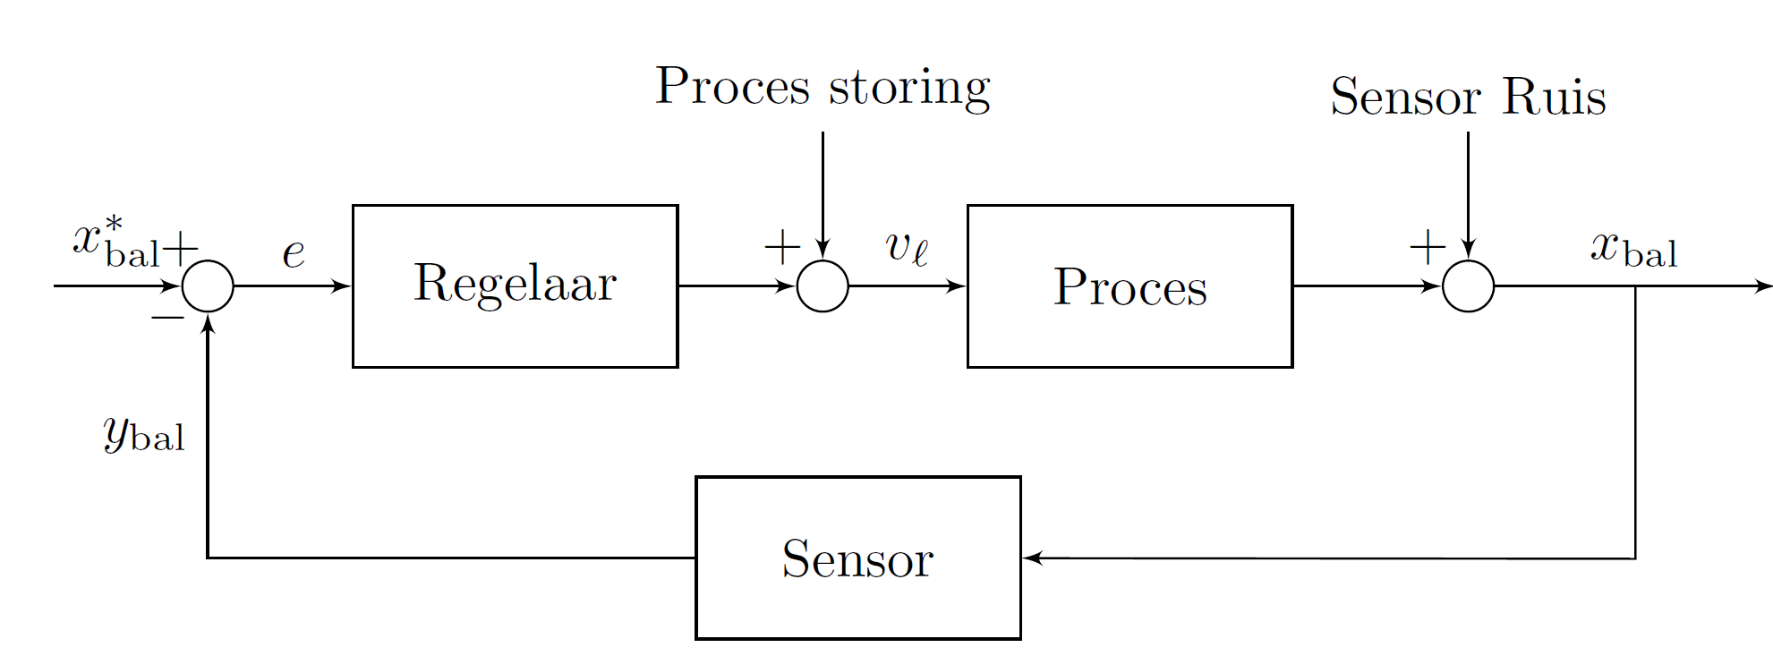
Feedback and control algoritmh
Disturbance
Sensor noise
Controller
Process
Sensor
Sensor dynamics: Usually much faster than process (e.g. thermocouple)
Control algorithm: Algorithm to modify input based on measured value and option setpoint
Optimize speed, energy cost, stabilize, tracking (error=0)
Notes:
Om de positie van de bal naar een gewenste positie te brengen, gaan we gebruik maken van een sturing of regelalgorime.
Een regelalgoritme zal, zolang de gewenste positie niet bereikt is, de ingang bijsturen. Het verschil tussen gewenste waarde en gemeten waarde heet de fout.
We passen dus zelf niet niet meer de ingang aan, maar het algoritme doet dit.
Een gangbare, maar verre van optimale en die voor bais kan zorgen is een on/off regeling. Dit kennen we van de centrale verwarming, waar zolang de gewenste temperatuur niet bereijkt worden de verwarming aan gaat. Eenmaal bereikt gaat de verwarming uti. Typisch gaat de uitgang dat in een sorot band rond de wenswaarde liggen, met vaak veel energiegvebruik.

Slide 8
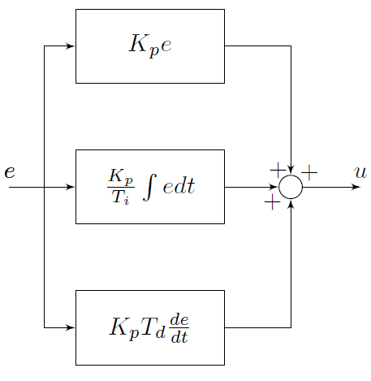
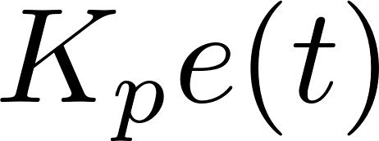
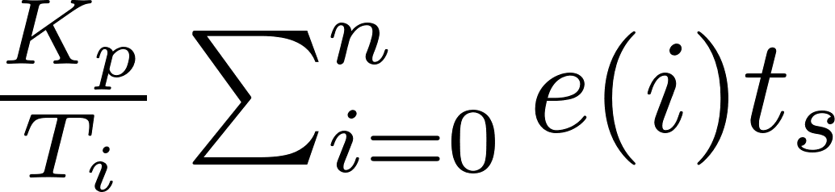
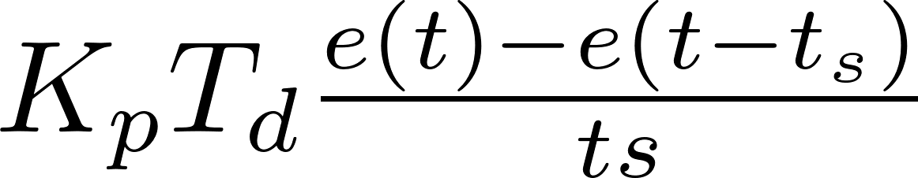
Control algorithm
P: control as long as there is an error
I: control as long as a sum of error
D: control as long as there is a derivative of the error
Notes:
In deze les gaan we doordachter om met controle. Een gekent algoritme is de PID waarde, die op basis van de fout, en de integral en afgeleide er. De P, of proportioneel is redelijk intuitief. Zolang de fout niet 0, blijf bijsturen. De D of differential zal bijsturen zolang de fout wijzigd. De I-actie of integrende actie de fout optellen (die positief of negatief kan zijn). Typisch zal dit er voor zorgen dat, als met een P regelaar er een fout blijft, deze wordt weggerelegld.

Slide 9
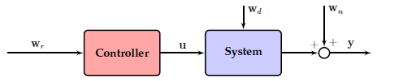
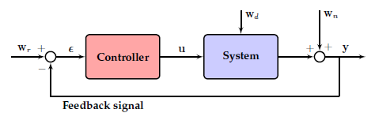
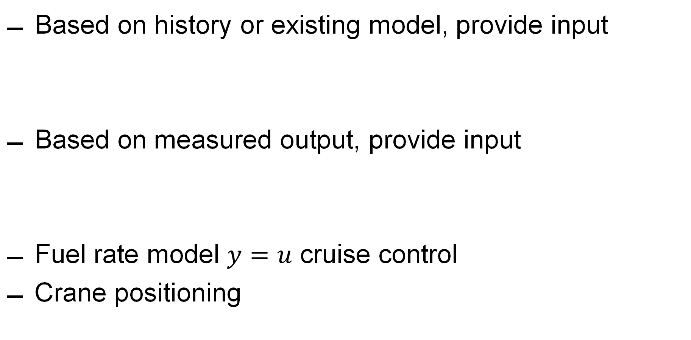
Open vs CLOSD
Based on history or existing model, provide input
Based on measured output, provide input
Fuel rate model $y=u$ cruise control
Crane positioning

Slide 10
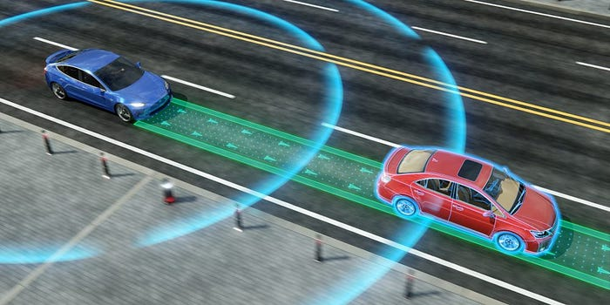
Self driving
Vehicle dynamics
Tracking road
Disturbance road
Sensors & GPS
Decide fuel and steer angels based on this information

Slide 11
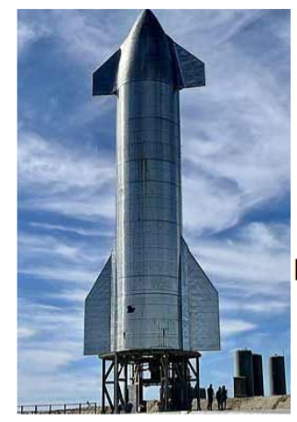
Aerospace
Rocket dynamics
Stabilize and desired location
Side and main thrusters
https://users.ugent.be/~kdkemele
/rocket2018/

Slide 12
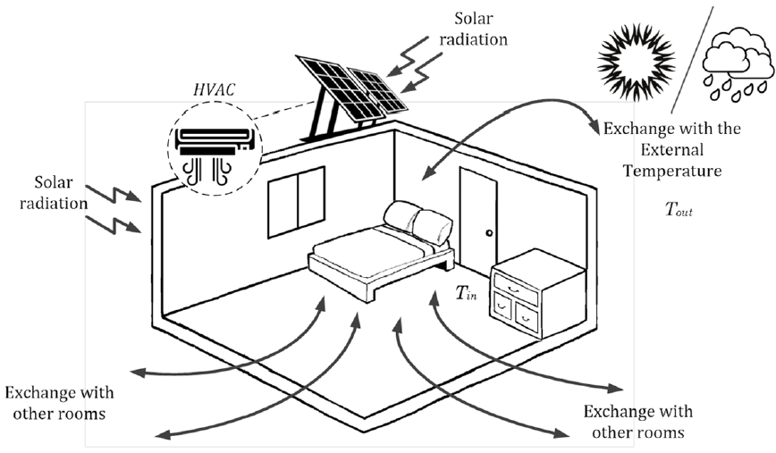
HEATING
Heating room
Disturbance (window, sun)
Lowering energy use
Energy balance

Slide 13
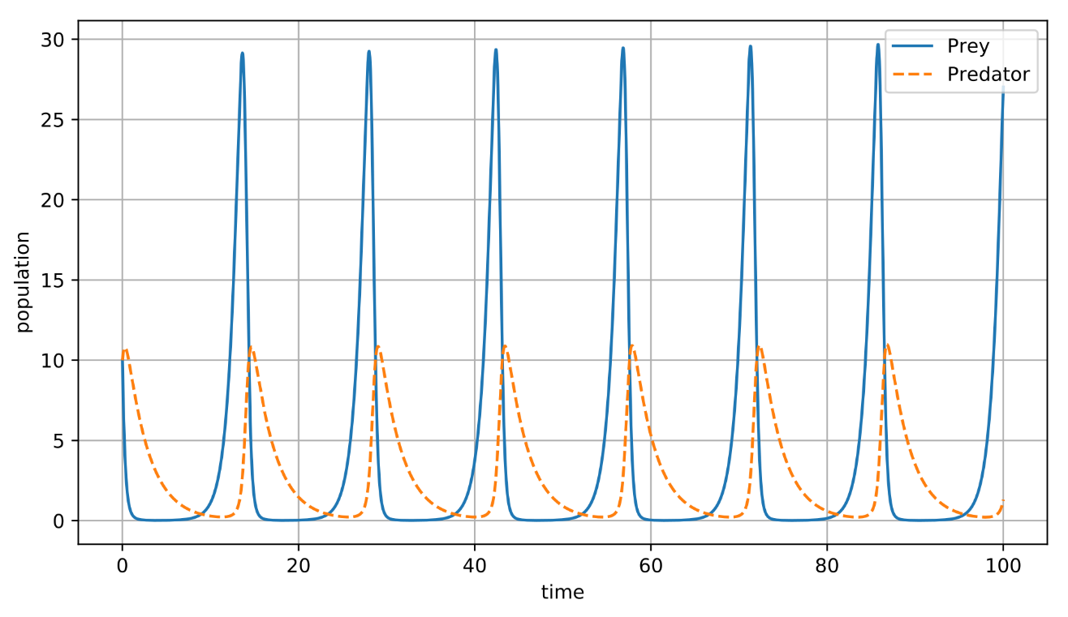
predator Prey/ Infection
Many prey -> many predators
Too much compitino and less food -> less predators
Less predators -> more prey
Compition model
What happens with disturbance?

Slide 14
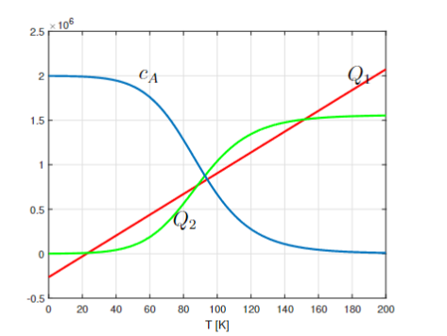
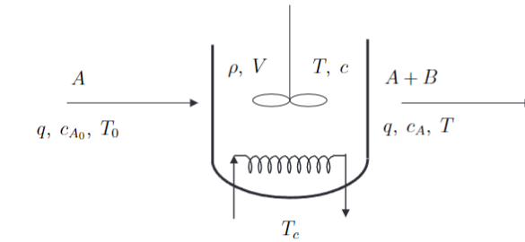
(Bio) Chemical reactor
Balance Removed heat = generated heat
‘Instable’ points might provide best generation of substance B
Feedback

Slide 15
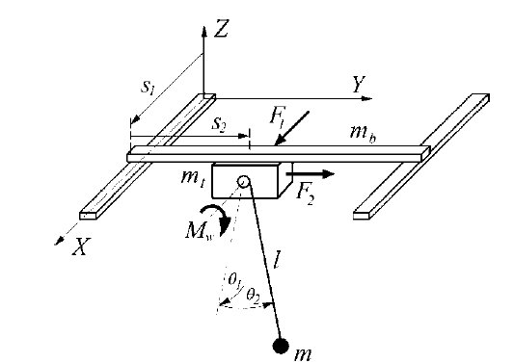
Steel factory

Slide 16
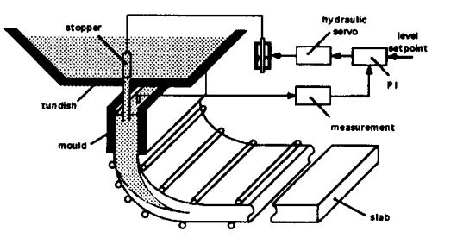
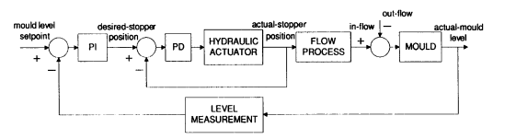
Continuous caster
Level of steel control
Determines quality
Two cascades systems
Stopper (fast)
Level of caster (slow)

Slide 17
State Space

Slide 18
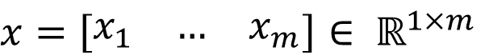
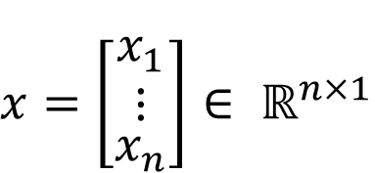
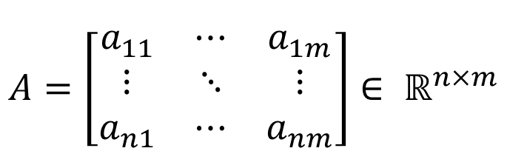
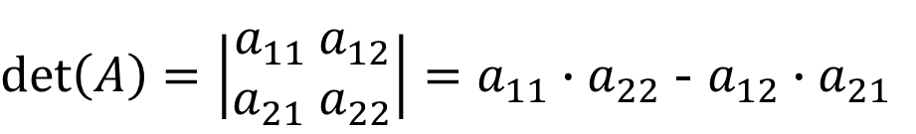
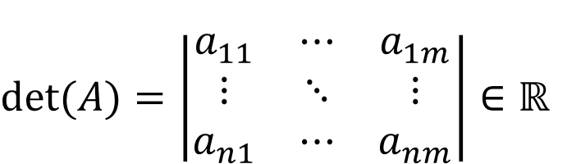
Matrices and vectors
Matrix Vectors
Determinant
$$A=\left[\begin{matrix}a_{11} & ⋯ & a_{1m} \\ ⋮ & ⋱ & ⋮ \\ a_{n1} & ⋯ & a_{nm}\end{matrix}\right]∈ ℝ^{n×m}$$
$x=\left[\begin{matrix}x_{1} & … & x_{m}\end{matrix}\right]$ $∈ ℝ^{1×m}$
$x=\left[\begin{aligned}\begin{matrix}x_{1} \\ ⋮\end{matrix} \\ x_{n}\end{aligned}\right]$ $∈ ℝ^{n×1}$
$det⁡(A)=\left|\begin{matrix}a_{11} & ⋯ & a_{1m} \\ ⋮ & ⋱ & ⋮ \\ a_{n1} & ⋯ & a_{nm}\end{matrix}\right|∈ℝ$
$\det\left(A\right)=\left|\begin{aligned}a_{11} a_{12} \\ a_{21}{ a}_{22}\end{aligned}\right|=$ $a_{11}∙{ a}_{22}$ - $a_{12}∙{ a}_{21}$

Slide 19
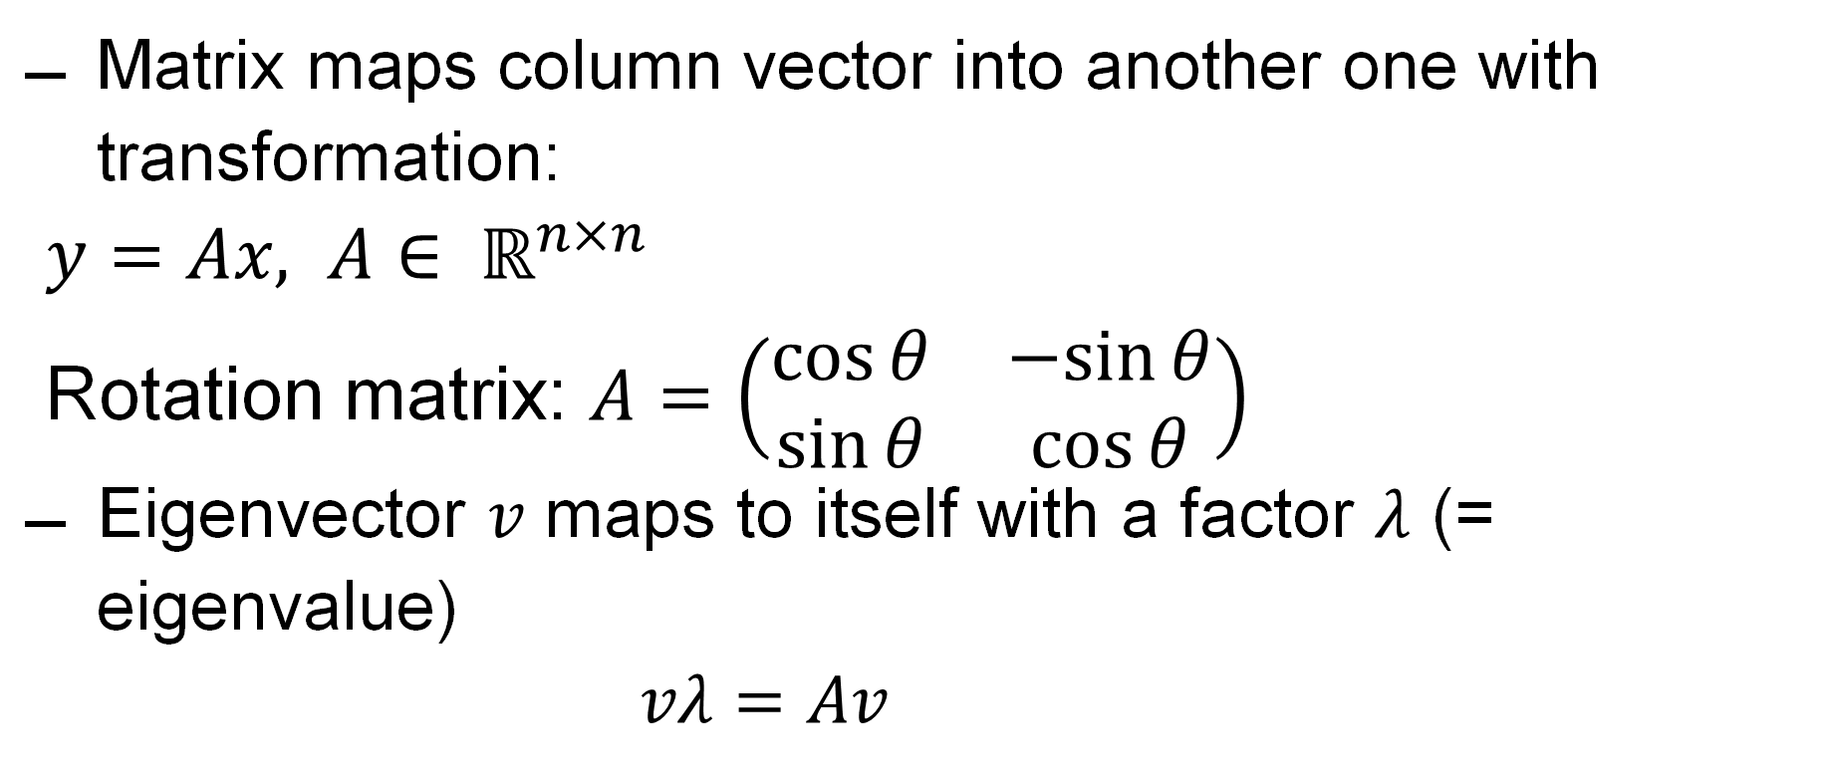
Eigenvectors and values
Matrix maps column vector into another one with transformation:
$y=Ax,$ $A∈ ℝ^{n×n}$
Rotation matrix: $A=\left(\begin{matrix}\cos{θ} & −sin{θ} \\ \sin{θ} & \cos{θ}\end{matrix}\right)$
Eigenvector $v$ maps to itself with a factor $λ$ (= eigenvalue)
$vλ=Av$

Slide 20
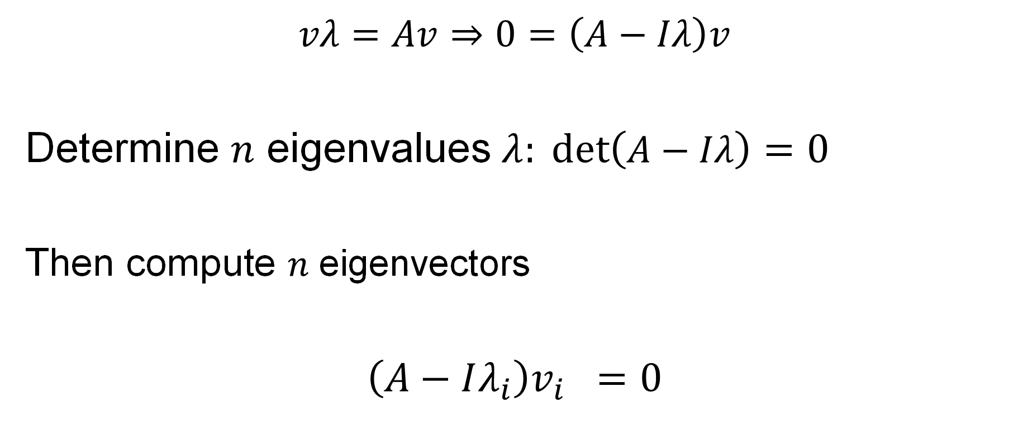
Eigenvectors and values: steps
$$vλ=Av⇒0=\left(A−Iλ\right)v$$
Determine $n$ eigenvalues $λ: \det\left(A−Iλ\right)=0$
Then compute $n$ eigenvectors
$$\left(A−Iλ_{i}\right)v_{i} =0$$

Slide 21
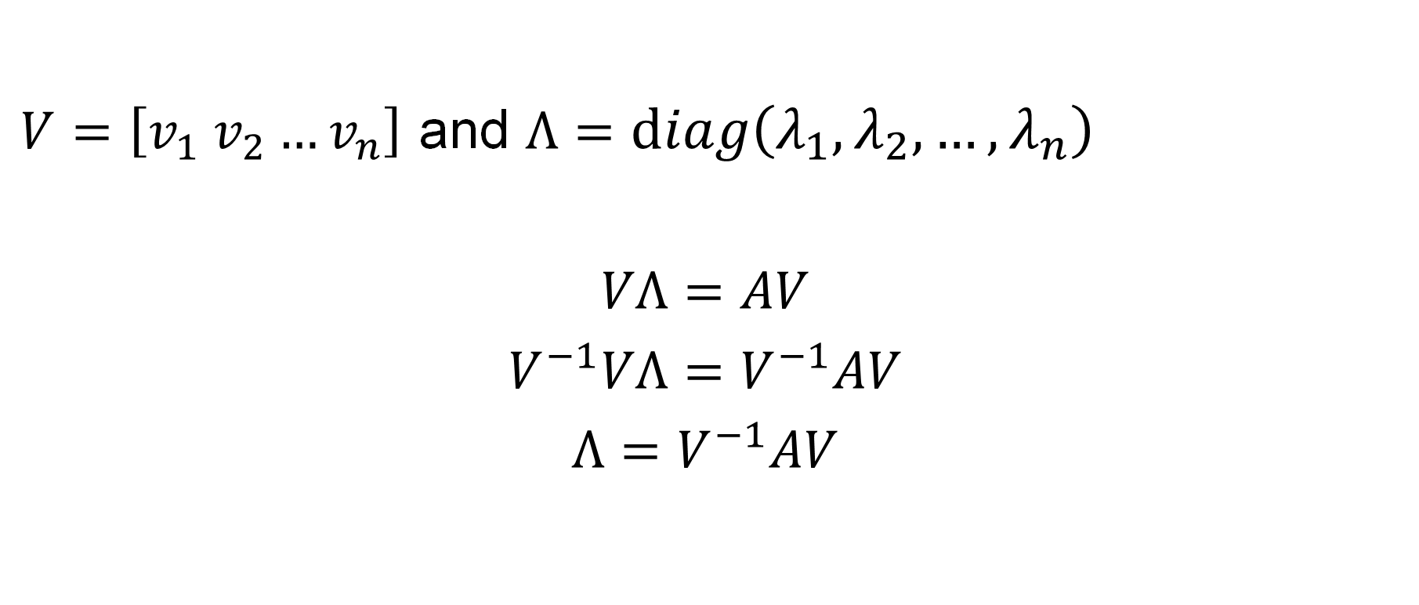
Eigenvector and values: Diagonalization
$V=\left[v_{1} v_{2}…v_{n}\right]$ and $Λ=diag\left(λ_{1},λ_{2},…,λ_{n}\right)$
$$VΛ=AV$$
$$V^{−1}VΛ=V^{−1}AV$$
$$Λ=V^{−1}AV$$

Slide 22
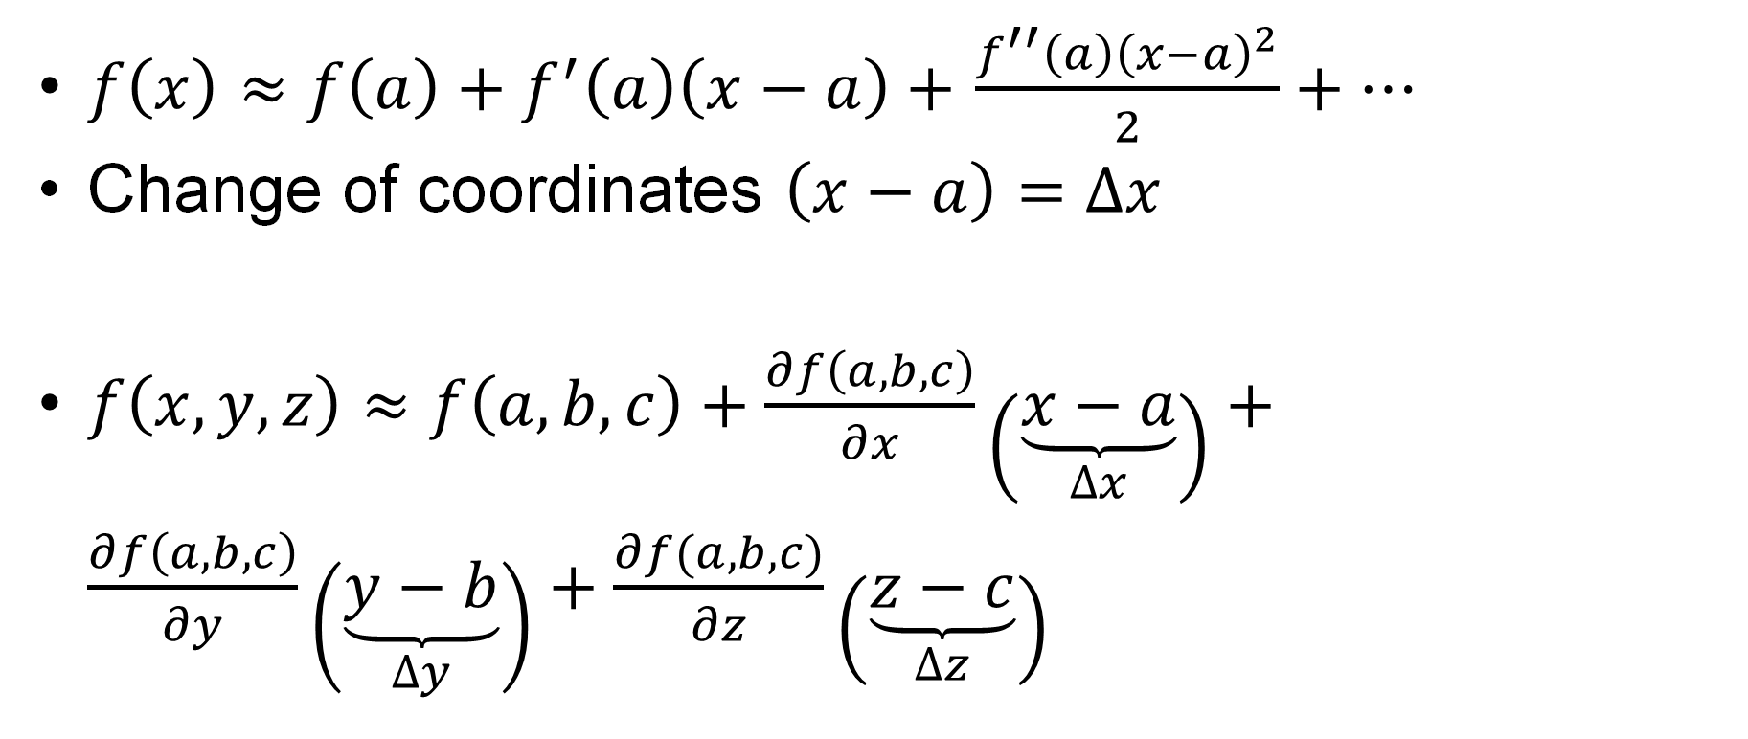
Basic Mathematics: Taylor series
$f\left(x\right)≈f\left(a\right)+f^{′}\left(a\right)\left(x−a\right)+$ $\frac{f^{′′}\left(a\right){\left(x−a\right)}^{2}}{2}+…$
Change of coordinates $\left(x−a\right)=$ $∆x$
$f\left(x,y,z\right)≈f\left(a,b,c\right)+\frac{∂f\left(a,b,c\right)}{∂x}\left(\underset{∆x}{\underbrace{x−a}}\right)+\frac{∂f\left(a,b,c\right)}{∂y}\left(\underset{∆y}{\underbrace{y−b}}\right)+\frac{∂f(a,b,c)}{∂z}\left(\underset{∆z}{\underbrace{z−c}}\right)$

Slide 23
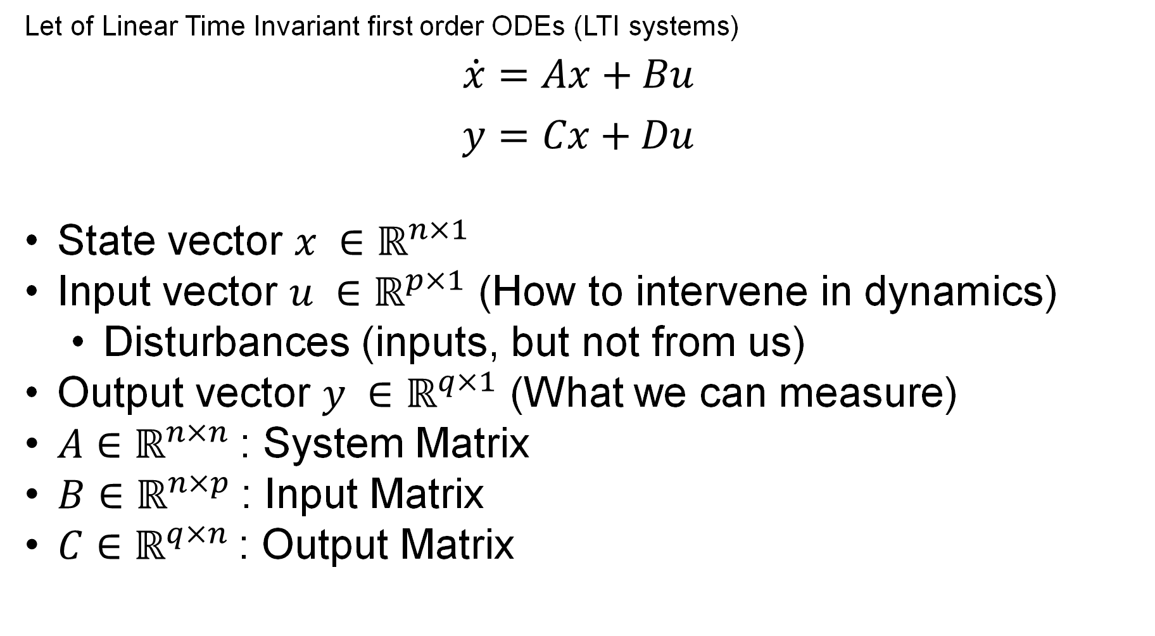
Models
Let of Linear Time Invariant first order ODEs (LTI systems)
$$\dot{x}=Ax+Bu$$
$$y=Cx+Du$$
State vector $x ∈ℝ^{n×1}$
Input vector $u ∈ℝ^{p×1}$ (How to intervene in dynamics)
Disturbances (inputs, but not from us)
Output vector $y ∈ℝ^{q×1}$ (What we can measure)
$A$ $∈ℝ^{n×n}$: System Matrix
$B$ $∈ℝ^{n×p}$: Input Matrix
$C$ $∈ℝ^{q×n}$: Output Matrix

Slide 24
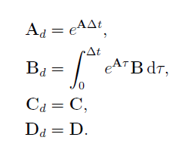
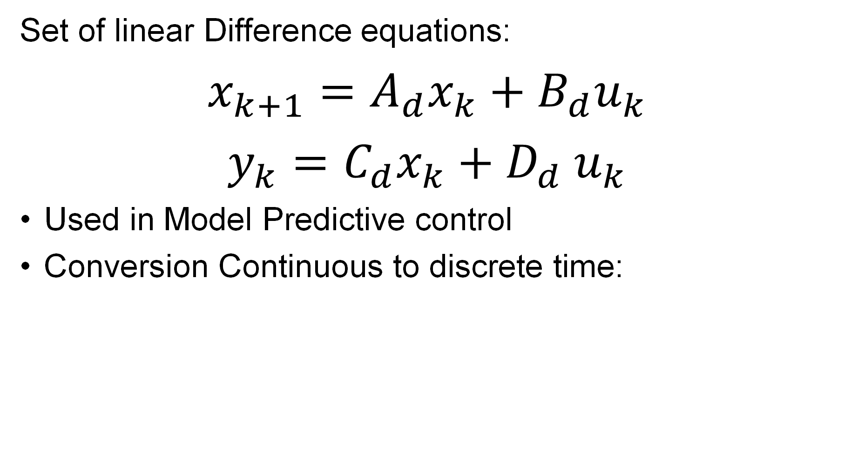
Models: Discrete time
Set of linear Difference equations:
$$x_{k+1}=A_{d}x_{k}+B_{d}u_{k}$$
$$y_{k}=C_{d}x_{k}+D_{d}{ u}_{k}$$
Used in Model Predictive control
Conversion Continuous to discrete time:

Slide 25
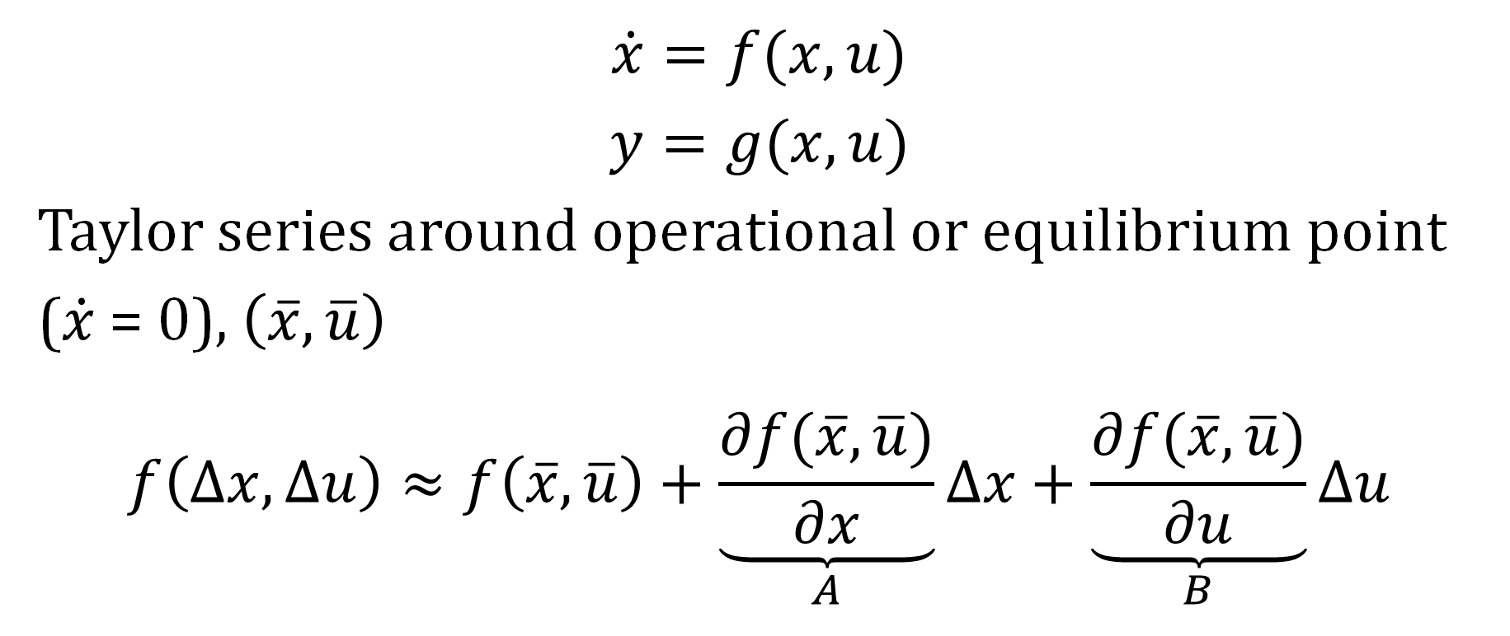
Linearization
$$\dot{x}=f(x,u)$$
$$y=g(x,u)$$
Taylor series around operational or equilibrium point ($\dot{x}$ = 0), $\left(\overline{x},\overline{u}\right)$
$$f\left(∆x,∆u\right)≈f\left(\overline{x},\overline{u}\right)+\underset{A}{\underbrace{\frac{∂f(\overline{x},\overline{u})}{∂x}}}∆x+\underset{B}{\underbrace{\frac{∂f(\overline{x},\overline{u})}{∂u}}}∆u$$

Slide 26
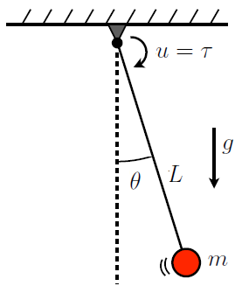
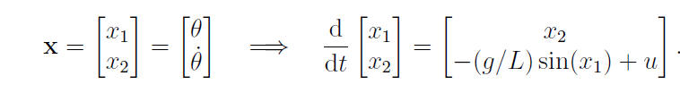
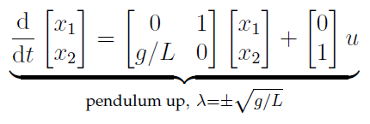
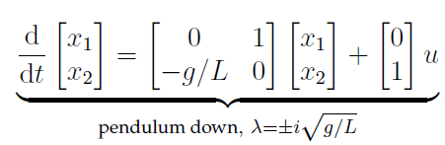
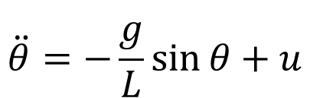
Pendulum
$$\ddot{θ}=−\frac{g}{L}\sin{θ}+u$$

Slide 27
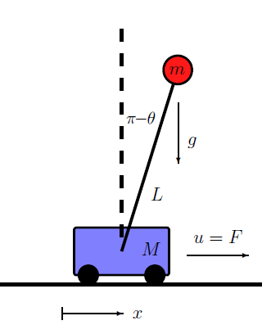
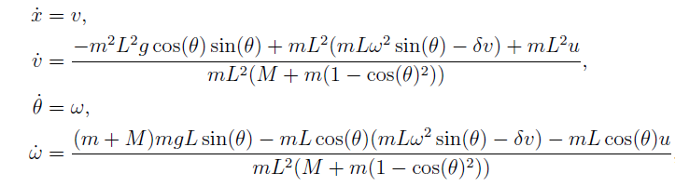
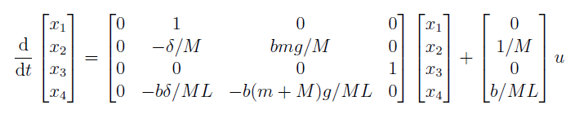
Pendulum on cart = Crane
b = 1 (up)
b = -1 (down)

Slide 28
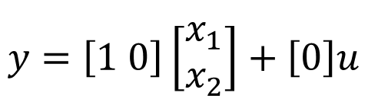
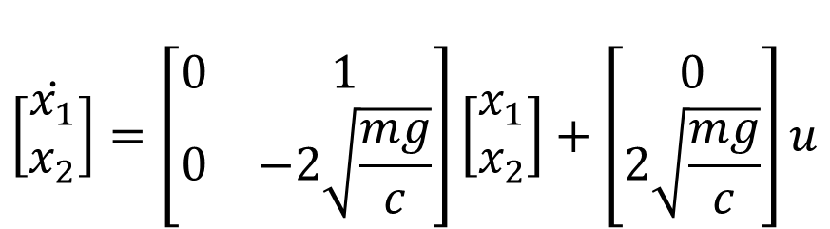
Levitation of ball
$$\dot{\left[\begin{matrix}x_{1} \\ x_{2}\end{matrix}\right]}=\left[\begin{matrix}0 & 1 \\ 0 & −2\sqrt{\frac{mg}{c}}\end{matrix}\right]\left[\begin{matrix}x_{1} \\ x_{2}\end{matrix}\right]+\left[\begin{matrix}0 \\ 2\sqrt{\frac{mg}{c}}\end{matrix}\right]u$$
$$y=\left[1 0\right]\left[\begin{matrix}x_{1} \\ x_{2}\end{matrix}\right]+\left[0\right]u$$
We only measure position

Slide 29
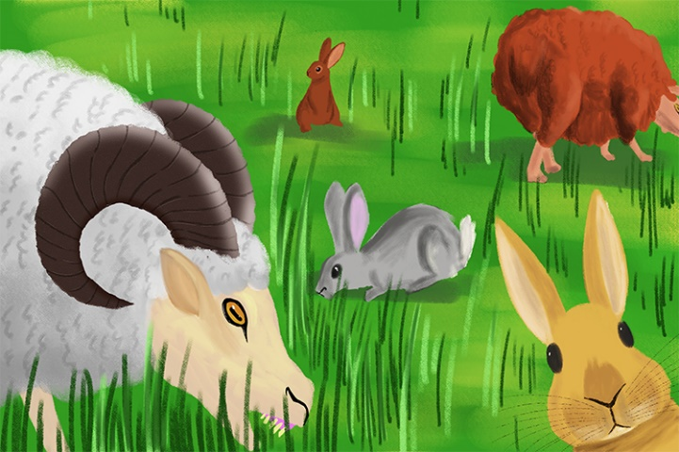
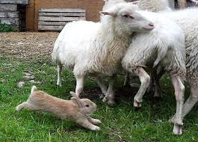
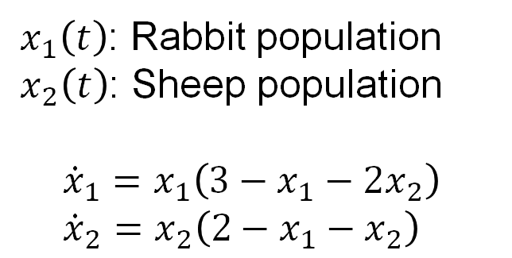
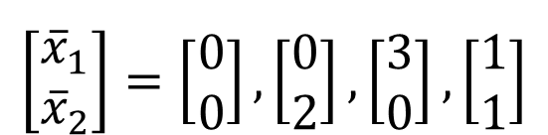

Competition model
$x_{1}\left(t\right)$: Rabbit population
$x_{2}\left(t\right)$: Sheep population
$${\dot{x}}_{1}=x_{1}\left(3−x_{1}−2x_{2}\right) \\ {\dot{x}}_{2}=x_{2}\left(2−x_{1}−x_{2}\right)$$
$$A=\left[\begin{matrix}3−2{\overline{x}}_{1} −2{\overline{x}}_{2} & −2{\overline{x}}_{1} \\ −{\overline{x}}_{2} & 2−{\overline{x}}_{1}−2{\overline{x}}_{2}\end{matrix}\right]$$
$$\left[\begin{matrix}{\overline{x}}_{1} \\ {\overline{x}}_{2}\end{matrix}\right]=\left[\begin{matrix}0 \\ 0\end{matrix}\right],\left[\begin{matrix}0 \\ 2\end{matrix}\right],\left[\begin{matrix}3 \\ 0\end{matrix}\right],\left[\begin{matrix}1 \\ 1\end{matrix}\right]$$

Slide 30


Eigenvalues & Eigenvectors
Autonomous system: $\dot{x}=Ax$
Solution $x\left(t\right)=e^{At}x(0)$ $e^{At}$ ???
Eigenvalues/vectots of $A$ , $Λ$ and $V$
Eigenmodes $Vz\left(t\right)=x$
$V\dot{z}=AVz⇒V^{−1}V\dot{z}=V^{−1}AVz$
$\dot{z}=Λ z⇒{z\left(t\right)= e}^{Λt}z(0)$
$A$ $∈ℝ^{n×n}$
$$e^{Λt}=\left[\begin{matrix}e^{λ_{1}t} & 0 & \begin{matrix}⋯ & 0\end{matrix} \\ \begin{aligned}0 \\ ⋮\end{aligned} & \begin{aligned}e^{λ_{2}t} \\ ⋮\end{aligned} & \begin{aligned}\begin{matrix}… & 0\end{matrix} \\ \begin{matrix}⋱ & 0\end{matrix}\end{aligned} \\ 0 & 0 & \begin{matrix}⋯ & e^{λ_{n}t}\end{matrix}\end{matrix}\right]∈ ℝ^{n×n}$$

Slide 31

Eigenvalues & Eigenvectors
$\dot{x}=Ax⇒ \dot{x}=VΛV^{−1}x$
Solution $x\left(t\right)=e^{VΛV^{−1}t}x(0)$ ${⇒Ve}^{Λt}V^{−1}x(0)$
$x_{k}\left(t\right)=\sum_{i=1}^{n}{v_{i}(k)}e^{λ_{i}t}{v_{i}^{−1}(k)x}_{i}(0)$
$λ_{i}=σ_{i}+jω_{i}$
What types of time responses are there??

Slide 32




Eigenvalues & Stability
$$ω$$
Oscillations
Process
Unstable
$$σ$$
Figures:
https://odysc.ugent.be

Slide 33



Eigenvalues & Stability
$$ω$$
Oscillations
Process
Unstable
$$σ$$

Slide 34
Eigenvalues, Eigenvectors & Stability
Eigenvalues in dynamical system meaning:
Stability & Speed
Response is exponential of eigenvalues, weighted by eigenvectors
(if x(0) is an eigenvector, you stay on this vector)

Slide 35
Pendulum

Slide 36
Pendulum on cart = Crane
SHOW IN PYTHON

Slide 37


Levitation of ball
$$\dot{\left[\begin{matrix}x_{1} \\ x_{2}\end{matrix}\right]}=\left[\begin{matrix}0 & 1 \\ 0 & −2\sqrt{\frac{mg}{c}}\end{matrix}\right]\left[\begin{matrix}x_{1} \\ x_{2}\end{matrix}\right]+\left[\begin{matrix}0 \\ 2\sqrt{\frac{mg}{c}}\end{matrix}\right]u$$
$$λ_{1,2}=0,−2\sqrt{\frac{mg}{c}}$$

Slide 38


Competition model
Intervene by adding/removing sheep or rabbits
=FEEDBACK
$$\left[\begin{matrix}{\overline{x}}_{1} \\ {\overline{x}}_{2}\end{matrix}\right]=\left[\begin{matrix}0 \\ 0\end{matrix}\right],\left[\begin{matrix}0 \\ 2\end{matrix}\right],\left[\begin{matrix}3 \\ 0\end{matrix}\right],\left[\begin{matrix}1 \\ 1\end{matrix}\right]$$

Slide 39

‘Forced’ response
$\dot{x}=Ax+Bu$
$x\left(t\right)= \int_{0}^{t}{e^{A\left(t−τ\right)}Bu\left(τ\right)dτ}$ (convolution integral)
Forced response
Transient determined by eigenvalues & vectors
Steady state part, weighted version of u
Python example: Intro to control toolbox
Response to frequency: gain and phase
See later (Input/Output & Laplace)

Slide 40


Example forced: Suspension
Parameter | Value
Sprung mass $m_{s}$ | 332 kg
Unsprung mass $m_{u}$ | 100 kg
Suspension spring $k_{s}$ | 48000 N/m
Tire spring $k_{t}$ | 200 000 N/m
Suspension damper $c_{s}$ | 1000 Nm/s
Lajqi, S., & Pehan, S. (2012).
Designs and optimizations of active and semi-active non-linear suspension systems for a terrain vehicle.
Strojniški vestnik-Journal of Mechanical Engineering, 58(12), 732-743.

Slide 41

State feedback
Eigenvalues determine stability, speed & oscillations
Can we choose $u$ such that we can change the eigenvalues? STATE FEEDBACK = $u=−Kx$
$$\dot{x}=Ax+Bu$$
$$\dot{x}=\underset{New system matrix}{\underbrace{\left(A−BK\right)}}x$$
Requires FULL state knowledge

Slide 42

Controllability
Controllability matrix
$$C=[B AB A^{2}B ⋯A^{n−1}B]$$
If rank matrix is $n$, system is controllable
Arbitrary eigenvalue placement through state feedback $u=−Kx$
Reachability: any state $x$ can be reached in finite time, for some $u$
Python inverted pendulum

Slide 43

Pole Placement
$$ω$$
Eigenvalue on the real axis
As negative as possible?
Python command ‘Place’
Inverted pendulum example
$$\dot{x}=\underset{New system matrix}{\underbrace{\left(A−BK\right)}}x$$
$$σ$$

Slide 44
Pole Placement
Why is there a balance?
Nonlinear might not be actually stable??
Constraints?
Control Effort
Stabilisation Speed
Weighted cost

Slide 45

Designing feedback: Linear Quadratic control
Controllabilty means a $u=−Kx$ can stabilize and change eigenvalues. How to choose $K$ ?
Weight optimization between fast stabilization and input cost
$J=\int_{0}^{∞}{(x^{T}Qx+u^{T}Ru) dt} J=\sum_{n=0}^{∞}{x^{T}Qx+u^{T}Ru}$
$Q:Weight matrix states$
$R:Weight matrix input$ (“Energy”)

Slide 46


Designing feedback: Linear Quadratic control
$J=\sum_{n=0}^{∞}{x^{T}Qx+u^{T}Ru}$
Optimal $K_{r}=R^{−1}B^{T}S$
Where $S$ is the solution of a ‘stationary Ricatti’ equation:
$A^{T}S+SA−SBR^{−1}B^{T}S+Q=0$
Inverted pendulum example

Slide 47

Designing feedback: LQR reference
We want $x=x_{r}$
$\dot{x^{∗}}=Ax^{∗}+Bu^{∗} where x^{∗}=x− x_{r}$ and $u^{∗}=u− u_{r}$
Stable if $u^{∗}$= $−Kx^{∗}$
$0=Ax_{r}+Bu_{r}$
So same optimization holds, different meaning input cost

Slide 48


State estimation
Until now: Knowledge full state $x$
Output equation!
Not all state can be measured because
of limited sensors, measurement locations
$$y=Cx+Du$$

Slide 49

Observability
Observability matrix$O=\left[\begin{matrix}C \\ CA \\ CA^{2} \\ \begin{aligned}⋮ \\ CA^{n−1}\end{aligned}\end{matrix}\right]$
If rank matrix is $n$, system is observable
any state $x$ can be estimated from $y$ in finite time, for some $u$
Similar like controllability second meaning!

Slide 50


Observer
Estimated dynamics based on $y$
Estimation error dynamics: $ε=x−\hat{x}$
$\dot{ε}=\left(A−K_{f}C\right)ε$
Pole placement/stabilisation! But how to choose $K_{f}$?
$$\hat{\dot{x}}=A\hat{x}+Bu+K_{f}(y−\hat{y})$$
$$\hat{y}=C\hat{x}$$
$$\hat{\dot{x}}=\left(A−K_{f}C\right)\hat{x}+[B K_{f}]\left[\begin{matrix}u \\ y\end{matrix}\right]$$

Slide 51




Kalman Filter
Observer gain optimization under system and measurement noise
$\dot{x}=Ax+Bu+w_{d},{ w}_{d} ∈ ℝ^{n×1}, in 𝒩(0,σ_{d}^{2}$)
$y=Cx+Du+w_{n}$, ${ w}_{n} ∈ 𝒩(0,σ_{n}^{2}$)
$𝔼(w_{d}$)=$𝔼(w_{n}$)=0 $𝔼(w_{d}w_{d}^{T}$)=$V_{d} 𝔼(w_{n}w_{n}^{T}$)=$V_{n}$
$$\dot{ε}=\left(A−K_{f}C\right)ε+{ w}_{d}−K_{f}v_{k}$$
$$J=𝔼\left(εε^{T}\right)$$
Optimal $K_{f}=SC^{T}V_{n}^{−1}$
Where $S$ is the solution of a ‘stationary Ricatti’ equation:
$${SA}^{T}+AS−SC^{T}V_{n}^{−1}CS+V_{d}=0$$
Large input noise: Trust measurement, more gain
Large output noise: Trust estimation, less gain
Matlab example

Slide 52


Estimation & control

Slide 53
Example: Inverted pendululm
Robustness? Does control still work if model estimation wrong?
https://www.youtube.com/watch?v=D3bblng-Kcc

Slide 54

Advanced topics?
Nonlinear Kalman
Reduced observer (not all states)
Stopgap: Linear Parameter varying:
$$\dot{x}=A(t)x+B(t)u$$
Advanced libraries usually MATLAB & SIMULINK

Slide 55
References
Linear Systems (Course Ghent University, Gert De Cooman)
Control System Design and Management (Course University of Newcastle, Julio Braslavsky)
Brunton, S. L., & Kutz, J. N. (2022). Data-driven science and engineering: Machine learning, dynamical systems, and control. Cambridge University Press.
Chevalier, A., Dekemele, K., Juchem, J., & Loccufier, M. (2021). Student feedback on educational innovation in control engineering: active learning in practice. IEEE Transactions on Education, 64(4), 432-437.
Strogatz, S. H. (2018). Nonlinear dynamics and chaos: with applications to physics, biology, chemistry, and engineering. CRC press.

Slide 56
Input-output models

Slide 57


Laplace transform
The Laplace transform:
In short: to go from differential - to algebraic equations

Slide 58




From state-space to input-output models
We are interested in the relationship between the inputs and (measurable) outputs (i.e. not necessarily all the states)
Consider a linear system
Often: $D=0$
$$G\left(s\right)=C{\left(sI−A\right)}^{−1}$$
Laplace transform:

Slide 59
Mimo control

Slide 60


Beam rolling: example
Goal: track static reference thickness $w_{r}$
Notes:
Explain process
Beam deformation
Two direction apply
Control rolling force
Also uncontrolled variables: gap thickness
Input is a force
Focus on robust control (i.e. against disturbances)
Advanced control techniques developed throughout the example (illustration)
Goal is to develop some feeling with these techniques, what they mean, how they apply, challenges

Slide 61





Beam rolling: Process (x-direction)
$u$: controlled input
$w_{e}$: eccentricity (disturbance)
$w_{i}$: input thickness (disturbance)
$δ:$ gap thickness (not measurable)
$f:$ rolling force (measurable)
Dynamics
Notes:
Start simple: neglect on direction

Slide 62








Basic control: PID
Easy tuning rules:
Oscillation test results in $K_{u}$
E.g. Ziegler-Nichols: $K_{P},K_{I},K_{D}$
More involved tuning based on some quality labels:
Overshoot
Settling time
$$R$$
$$u$$
$$y$$
$$PID$$
$$G_{p}$$
$$−$$

Slide 63




Beam rolling: LQR control (x-direction)
Define cost function:
Wherein
Result: control law
But…
Python exercise
Notes:
See earlier reference not important for optimal solution

Slide 64


LQG control
Boils down to: Kalman + LQR
Kalman to estimate the state
u: plant input
y: plant output
w: input disturbance
v: output disturbance
LQR, using an estimate of the full state:

Slide 65

Beam rolling: LQG control (x-direction)
$u$: controlled input
$w_{e}$: disturbance (eccentricity)
$w_{i}$: disturbance (input thickness)
$δ:$ gap thickness (not measurable)
$f:$ rolling force (measurable)
Python implementation

Slide 66


Beam rolling: x & y direction
Interactions exist:
Example: Poisson coefficient
Complicating control:
Input $u_{x}$ influences $f_{y}$
Input $u_{y}$ influences $f_{x}$
Cross coupling
How to deal with this?

Slide 67

Decoupled control
Coupling between $u_{i}$and $y_{j}$ exist
How to deal with this?
Ignore coupling (Decentralised Control):
LQR or LQG for separated models $→$ suboptimal solution
‘What is good for one might be bad for the other’
Take coupling into account (Centralised Control):
Difficult to comprehend
LQR or LQG: complicated model and often suboptimal
Decouple in control scheme!
To what degree do $u_{j}$and $y_{i}$ interact?
Relative Gain Array (RGA)

Slide 68






Decoupled control: Relative Gain Array (1)
Consider the input-output model: $y\left(s\right)=G\left(s\right)u\left(s\right)$
Gain from $u_{j}$to $y_{i}$ (all other loops open):
Gain from $u_{j}$to $y_{i}$ (all other loops closed):
With:
Relative gain:

Slide 69




Decoupled control: Relative Gain Array (2)
Apply a step input $∆u_{j }$keeping $u_{k}$constant ($k≠j$) and measure the output change $∆y_{i }$
Apply a step input $∆u_{j }$keeping $y_{k}$constant ($k≠j$) (i.e. keeping all other loops closed and measure the output change $∆y_{i }$

Slide 70


Beam Rolling: decoupling control (1)
Input-output model:
With:
&

Slide 71









Beam Rolling: decoupling control (2)
$$w_{r}$$
$$u$$
$$u^{∗}$$
$$f$$
$G^{∗}$ such that inputs and outputs are decoupled i.e. no interaction between $u_{x}$and $f_{y}$ and $u_{y}$and $f_{x}$
We aim at static decoupling: $\lim_{s→0}{sG(s)}={\tilde{G}}_{stat}$
$$G_{c}$$
$$G^{∗}$$
$$G_{p}$$
$G^{∗}$? $→$ Exercise

Slide 72



Beam Rolling: decoupling control (3)
We aim at static decoupling: $\lim_{s→0}{sG(s)}={\tilde{G}}_{stat}$
Consider the new input-output model:
Wherein:
Goal: find ${{\tilde{G}}_{stat}}^{∗}$for $y={\tilde{G}}_{stat}{{\tilde{G}}_{stat}}^{∗}u$ such that $y$ and $u$ are decoupled

Slide 73


Beam Rolling: Decentralised Control
Ignore interactions altogether
Design an LQR based on a model for the x-direction
Design an LQR based on a model for the y-direction
Apply inputs $u_{x}$ and $u_{y}$ as such
Justification:
The RGA method shows low degrees of interaction
Note: coupling $w_{e}$ & $w_{i}$ w.r.t. $f$ are not considered
RGA-matrix

Slide 74

Beam Rolling: Centralised Control
Model the plant completely (including interactions)
Design one LQR based on the full model
Apply inputs $u_{x}$ and $u_{y}$ as such (generated by the same LQR)
Justification:
The RGA method might show high degrees of interaction

Slide 75





Model Predictive Control (MPC):
Unaddressed topics so far:
Constraint equations
Nonlinear models
Dead time
Dealing measured disturbances
$→$ MPC
$$u$$
$$G_{p}$$
$$MPC$$
$$r$$

Slide 76

MPC:
MPC :
Feedback control for MIMO systems
Input based on real-time optimisation
Optimisation based on current state and predicted future output
Current time t

Slide 77






MPC
Based on a model (state-space):
Minimisation of the cost function, based on the predicted output $y\left(t+k | t\right), k=1…N$ (and therefore the predicted error) results in $u\left(t+k | t\right), k=1…N$ over the prediction horizon
Only $u\left(t+1 | t\right)$ applied
And a well-defined cost function: $J(x,u,y)$
Taking into account some constraints:
Possibly: ${(N}_{u}<N)$

Slide 78

Process: Industrial polymerisation reactor
Input
Ref: https://www.do-mpc.com/en/latest/example_gallery/industrial_poly.html

Slide 79



Model through conservation
Parameter uncertainty
$$m_{F}^{acc}={\dot{m}}_{F}$$
$$T_{adiab}=\frac{ΔH_{R}}{c_{p,R}}\frac{m_{A}}{m_{A}+m_{W}+m_{P}}+T_{R}$$

Slide 80


Constraints

Slide 81


Objective
Produce $m_{P}=20680 kg$ as fast as possible
Smooth control performance: penalty on input changes

